Slide 1
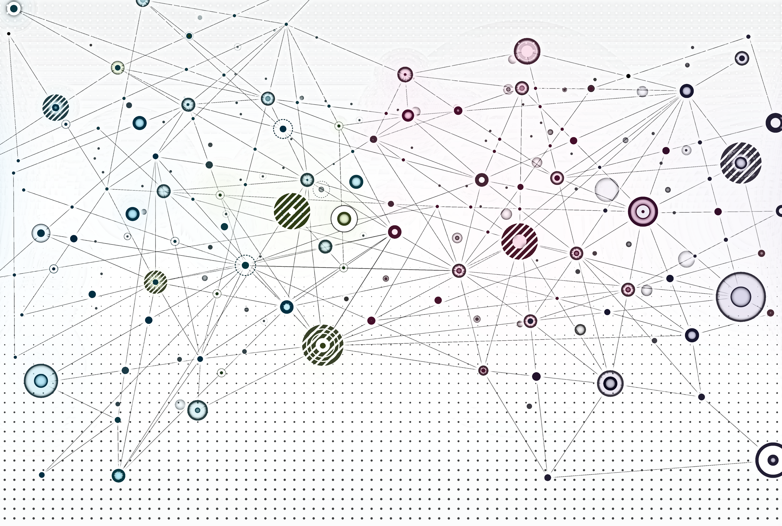
GNNs Theoretical Persepctive

Slide 2
Overview
Recap
GNN computation graphs
Theoretical analysis of GNN aggregation functions
Designing an injective GNN

Slide 3
Recap

Slide 4
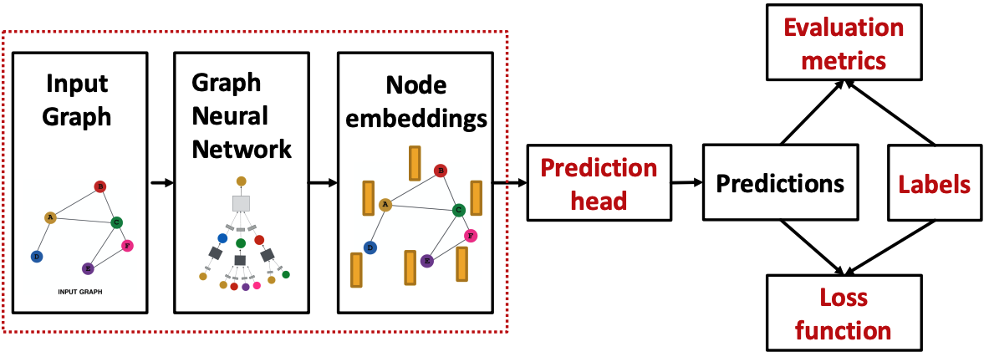
GNN training pipeline
Image credit: Jure Leskovec, http://cs224w.stanford.edu

Slide 5
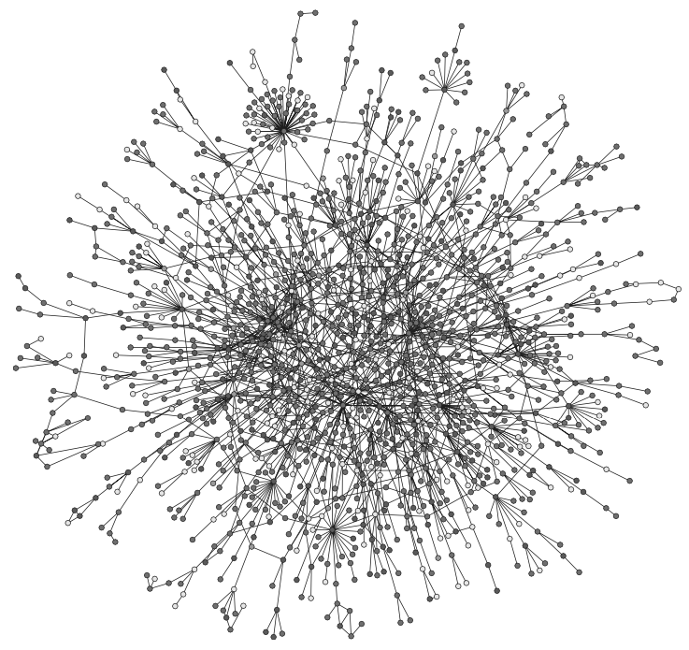
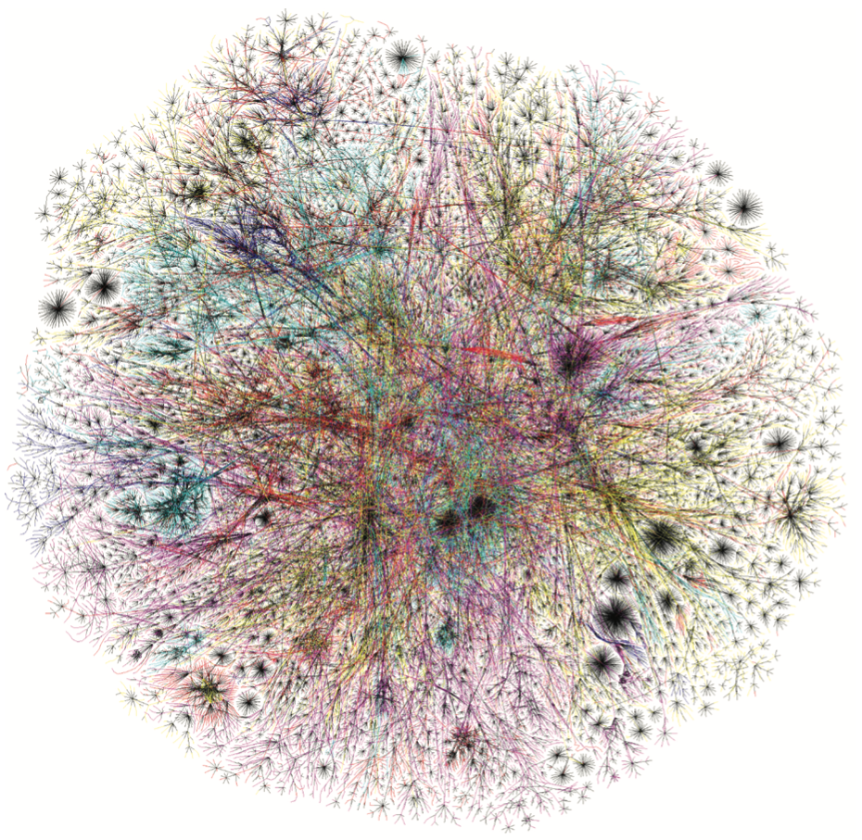
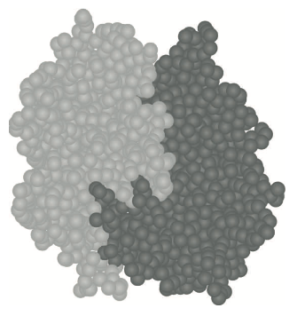
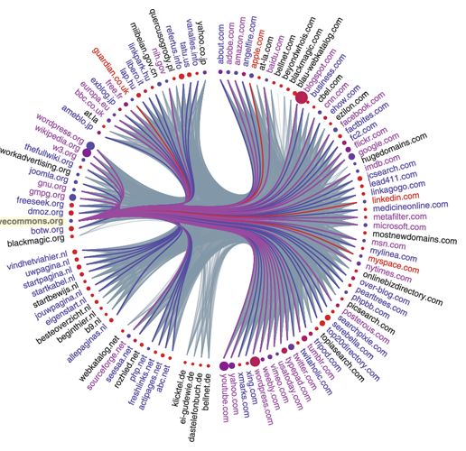

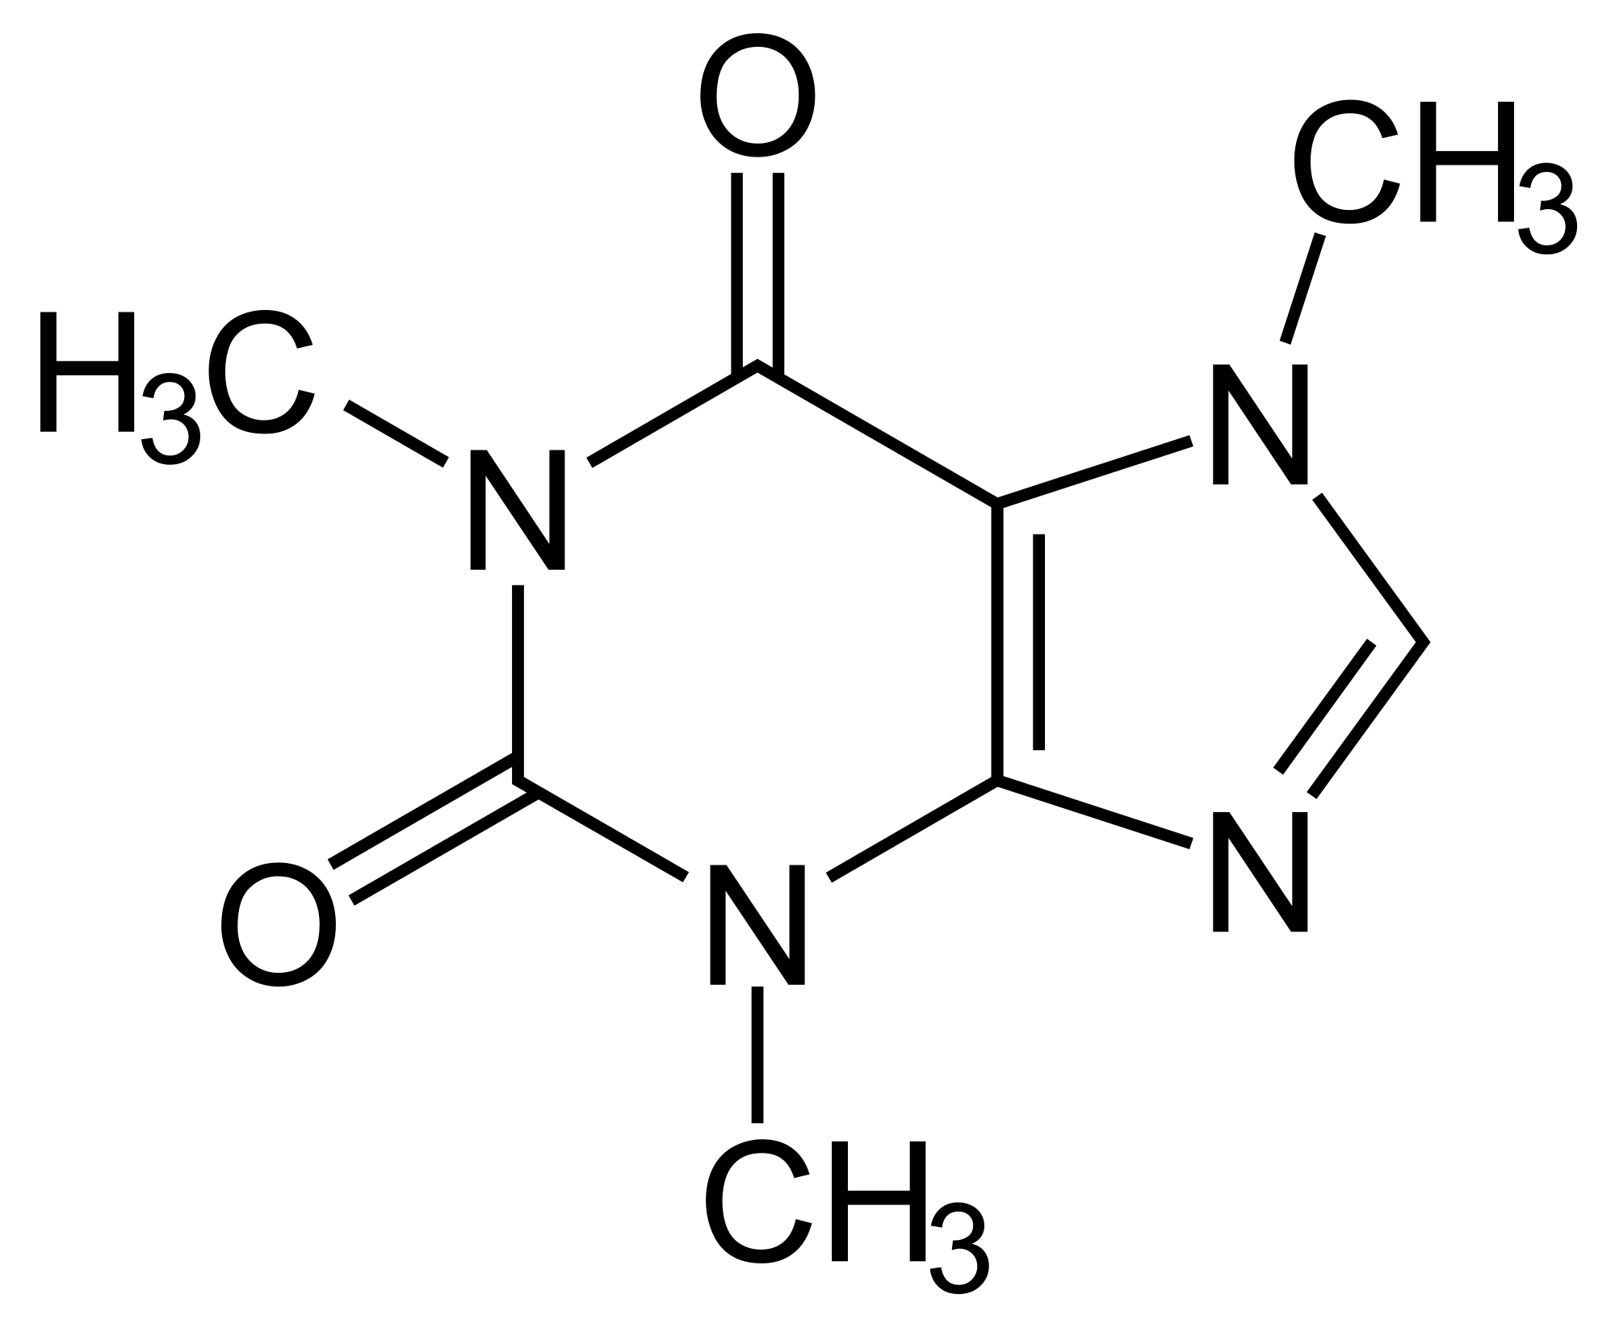
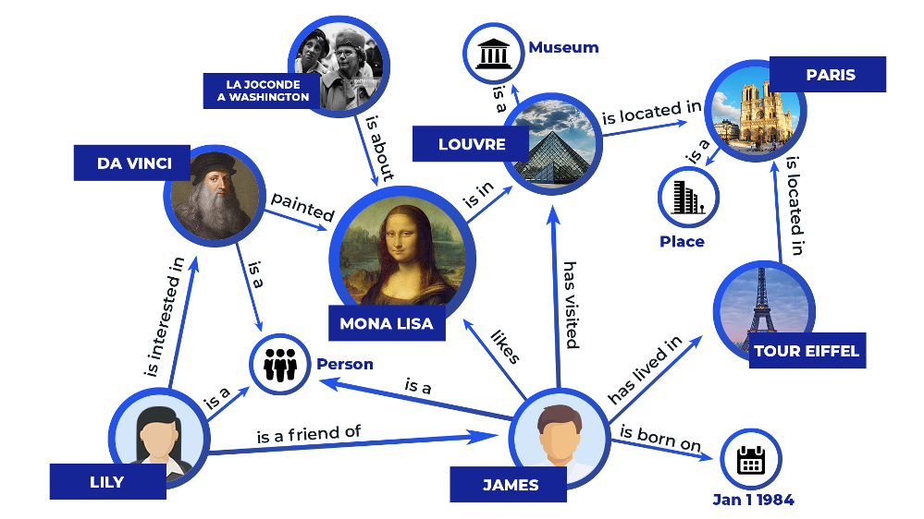
Information modalities in graphs
Technological networks
Information networks
Biological networks
Image credit: Newman 2018
Image credit: American Scientist
Image credit: Newman 2018
Social networks
Many more …
Image credit: Chemistry StackExchange
Image credit: Zilliz
Notes:
World wide web pages form a directional graph where nodes are web pages and edges are links from a source to destination page
Citation network where papers are nodes and directed edges go from paper A to paper B if A cites B
Databases can be viewed as graphs where tables (or individual rows) are nodes where edges indicate a key that connects the tables (or rows)
Recommender network is a bipartite graph where nodes are people and products where edges connect people to the product they recommend
Keyword index is a bipartite graph where words and pages are nodes and edges connect words to the pages on which they are used

Slide 6
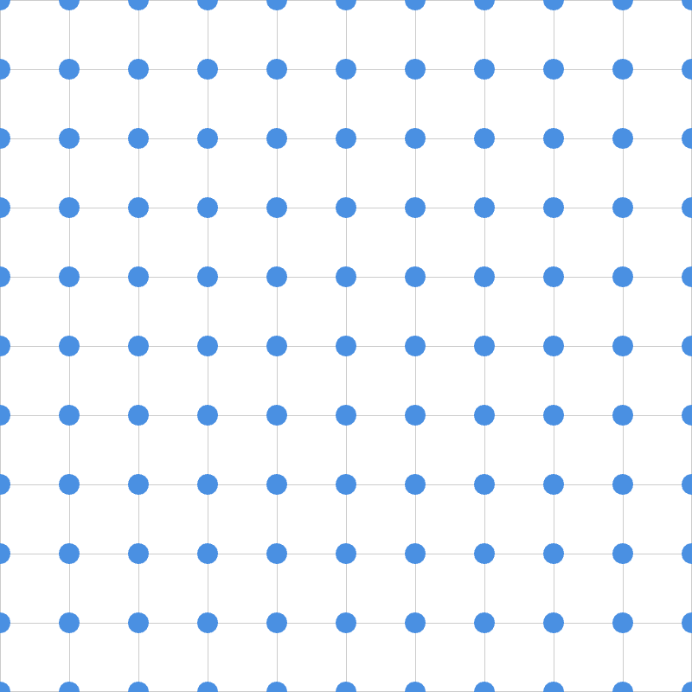
Why is graph deep learning hard?
Graphs have complex topological structure (i.e., irregular arrangement, no spatial locality like grids)
No fixed ordering or reference points
VS
Graph Data
Images
Text

Slide 7
Theory of GNNs
How expressive are GNNs?
Many GNN models have been proposed (e.g., GCN, GAT, GraphSAGE, …)
Last count, 67 different types of convolutional layers in PyG
How well can these GNN models distinguish between different graph structures?
How can we design a maximally expressive GNN model?

Slide 8
GNN computation graphs

Slide 9
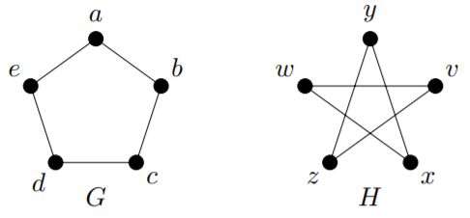
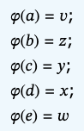
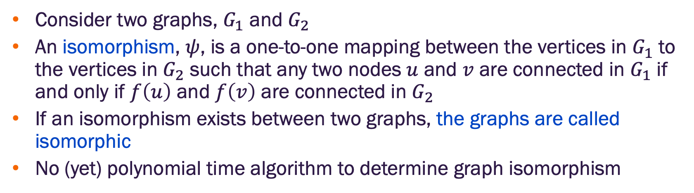
Graph isomorphism
Consider two graphs, $G_{1}$ and $G_{2}$
An isomorphism, $ψ$, is a one-to-one mapping between the vertices in $G_{1}$ to the vertices in $G_{2}$ such that any two nodes $u$ and $v$ are connected in $G_{1}$ if and only if $f\left(u\right)$ and $f\left(v\right)$ are connected in $G_{2}$
If an isomorphism exists between two graphs, the graphs are called isomorphic
No (yet) polynomial time algorithm to determine graph isomorphism

Slide 10
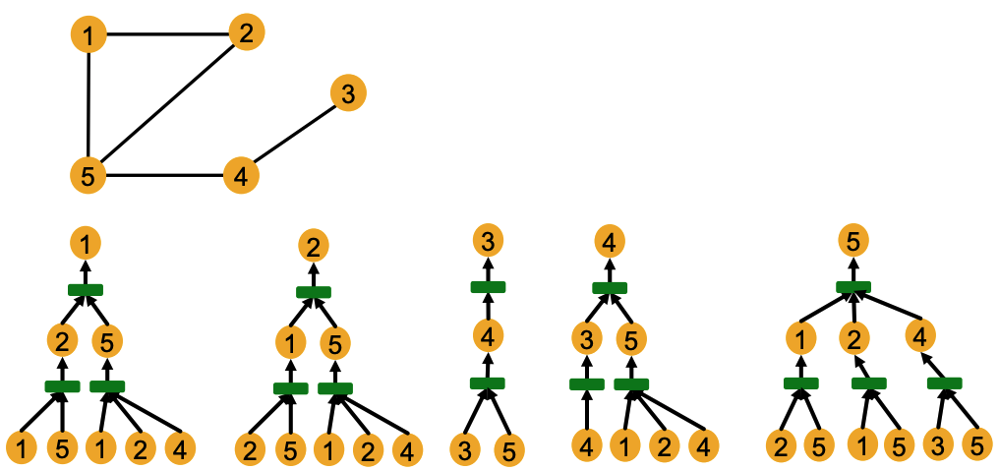
A simpler problem
Given a pair of nodes with different neighborhood structures, is there a GNN that can always differentiate them?
Image credit: Jure Leskovec, http://cs224w.stanford.edu

Slide 11
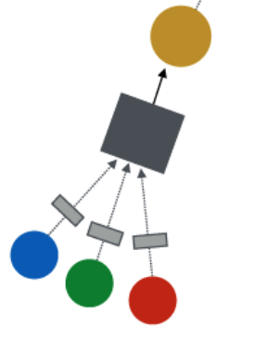
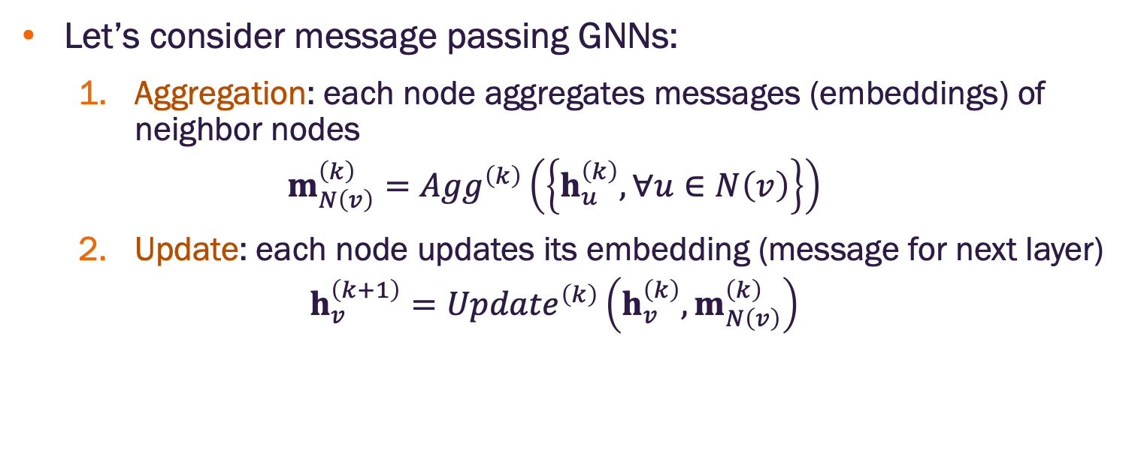
Single GNN layer
Let’s consider message passing GNNs:
Aggregation: each node aggregates messages (embeddings) of neighbor nodes
$$m_{N\left(v\right)}^{\left(k\right)}={Agg}^{\left(k\right)}\left(\left\{h_{u}^{\left(k\right)}, ∀u∈N\left(v\right)\right\}\right)$$
Update: each node updates its embedding (message for next layer)
$$h_{v}^{\left(k+1\right)}={Update}^{\left(k\right)}\left({h_{v}^{\left(k\right)},m}_{N\left(v\right)}^{\left(k\right)}\right)$$
Updated message
Aggregation
Messages
Image credit: Jure Leskovec, http://cs224w.stanford.edu

Slide 12
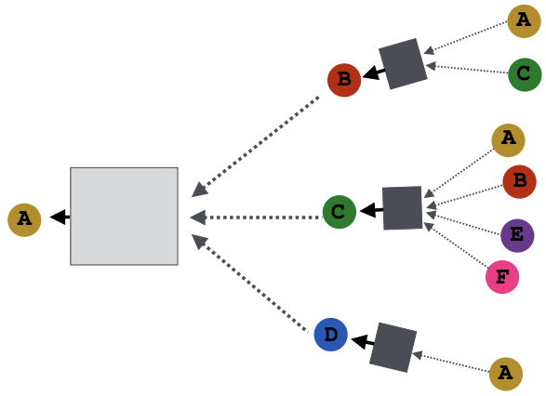
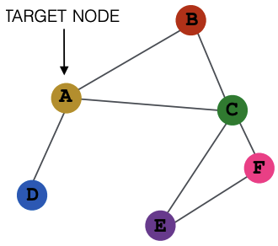
Many message passing GNN layers are possible
Input graph
Different GNN models (GCN, GAT, etc) use different neural networks
Image credit: Jure Leskovec, http://cs224w.stanford.edu

Slide 13
GCN with global mean pooling
Input graph
Element wise mean pooling (agg) + linear and ReLU (update)
Image credit: Jure Leskovec, http://cs224w.stanford.edu

Slide 14
GraphSAGE with global max pooling
Input graph
Neighbor sample and element wise max pooling (agg) + MLP (update)
Image credit: Jure Leskovec, http://cs224w.stanford.edu

Slide 15
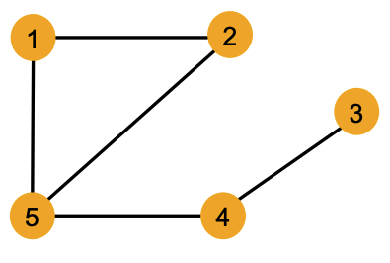
Can a GNN distinguish graph structures
Use node colors to indicate nodes with the same feature values (i.e., two nodes with the same color have the same input feature vector)
For example, the graph here assumes all nodes have the same feature
Question: Can a GNN always distinguish these nodes? IOW, will the embeddings be different for every node?
Image credit: Jure Leskovec, http://cs224w.stanford.edu

Slide 16
Local neighborhood structure
Consider the local neighborhood structure around each node in a graph
Example: Nodes 1 and 5 have different neighborhood structures indicated by the fact that they have different degrees
Image credit: Jure Leskovec, http://cs224w.stanford.edu

Slide 17
Local neighborhood structure
Consider the local neighborhood structure around each node in a graph
Example: Nodes 1 and 4 have the same degree 2. However, they have different neighborhood structures because their neighbors have different node degrees
Node 1 has neighbors with degrees 2 and 3
Node 4 has neighbors with degrees 1 and 3
Image credit: Jure Leskovec, http://cs224w.stanford.edu

Slide 18
Local neighborhood structure
Consider the local neighborhood structure around each node in a graph
Example: Nodes 1 and 2 have the same degree neighborhood structure because they are symmetric within the graph
Node 1 has neighbors with degrees 2 and 3
Node 2 has neighbors with degrees 2 and 3
Their second hop neighbors also have the same degrees (node 4 with degree 2
Image credit: Jure Leskovec, http://cs224w.stanford.edu

Slide 19
Local neighborhood structure
Question: Can GNN node embeddings distinguish different nodes’ local neighborhood structures?
Under what conditions do they succeed or fail?
Need to understand how local neighborhood structure determines GNN node embedding computation graph
Image credit: Jure Leskovec, http://cs224w.stanford.edu

Slide 20
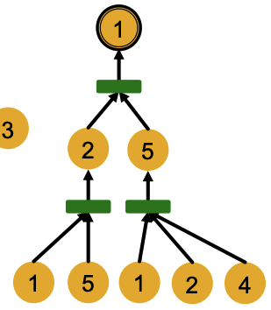
Computation graphs in a GNN
GNN layers generate node embeddings through a computational graph determined by the node neighborhood
Example: Computation graph for node 1
Image credit: Jure Leskovec, http://cs224w.stanford.edu

Slide 21
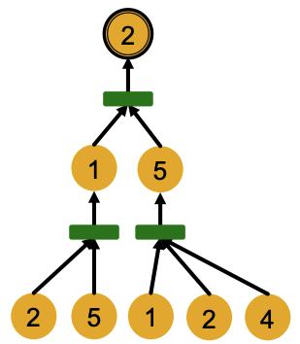
Computation graphs in a GNN
Compare computation graph for node 1 and node 2
Image credit: Jure Leskovec, http://cs224w.stanford.edu

Slide 22
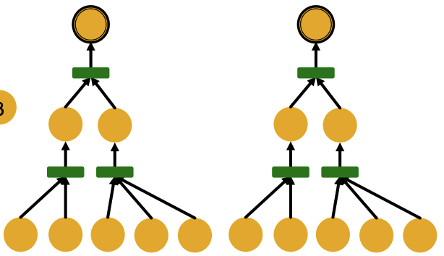
Computation graphs in a GNN
Compare computation graph for node 1 and node 2
The GNN only sees node features (not IDs):
Image credit: Jure Leskovec, http://cs224w.stanford.edu

Slide 23
Computation graphs in a GNN
Any message passing GNN with shared weights will generate the same embedding for nodes 1 and 2 because:
Computation graphs are identical
Node features (colors) are identical
Input to GNN computation does not include node IDs
1
2
GNN will not be able to distinguish nodes 1 and 2
Image credit: Jure Leskovec, http://cs224w.stanford.edu

Slide 24
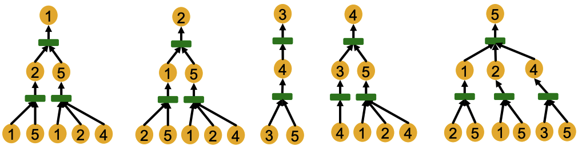
Computation graphs in a GNN
Local neighborhoods with different structures define different computation graphs
Image credit: Jure Leskovec, http://cs224w.stanford.edu

Slide 25
Computation graphs in a GNN
Local neighborhoods with different structures define different computation graphs
Image credit: Jure Leskovec, http://cs224w.stanford.edu

Slide 26
Computation graphs in a GNN
Computational graphs for each node are rooted trees where the node is the root
Rooted tree structures
(defined by recursively unfolding neighboring nodes from the root node
Image credit: Jure Leskovec, http://cs224w.stanford.edu

Slide 27
Computation graphs in a GNN
Computational graphs for each node are rooted trees where the node is the root
The most expressive GNN should map different rooted trees to different node embeddings (represented below by different colors)
Node embedding
Image credit: Jure Leskovec, http://cs224w.stanford.edu

Slide 28
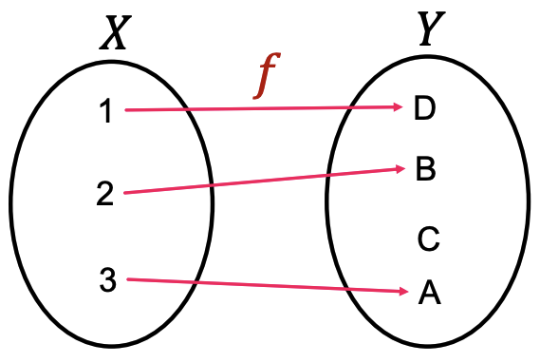
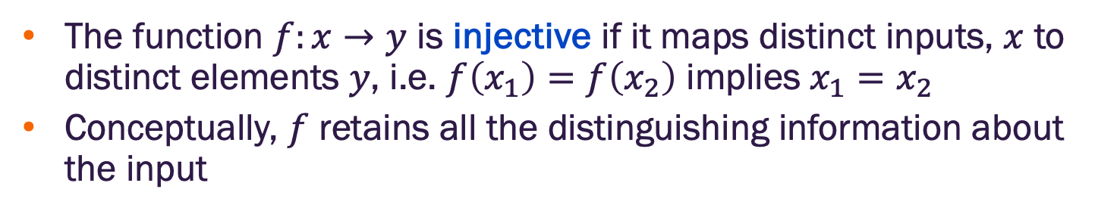
Injective function
The function $f:x→y$ is injective if it maps distinct inputs, $x$ to distinct elements $y$, i.e. $f\left(x_{1}\right)=f\left(x_{2}\right)$ implies $x_{1}=x_{2}$
Conceptually, $f$ retains all the distinguishing information about the input
Image credit: Jure Leskovec, http://cs224w.stanford.edu

Slide 29
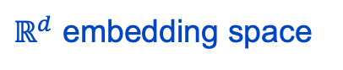
How expressive are GNNs?
The most expressive GNN should map rooted trees to node embeddings injectively
$ℝ^{d}$ embedding space
Rooted trees
Image credit: Jure Leskovec, http://cs224w.stanford.edu

Slide 30
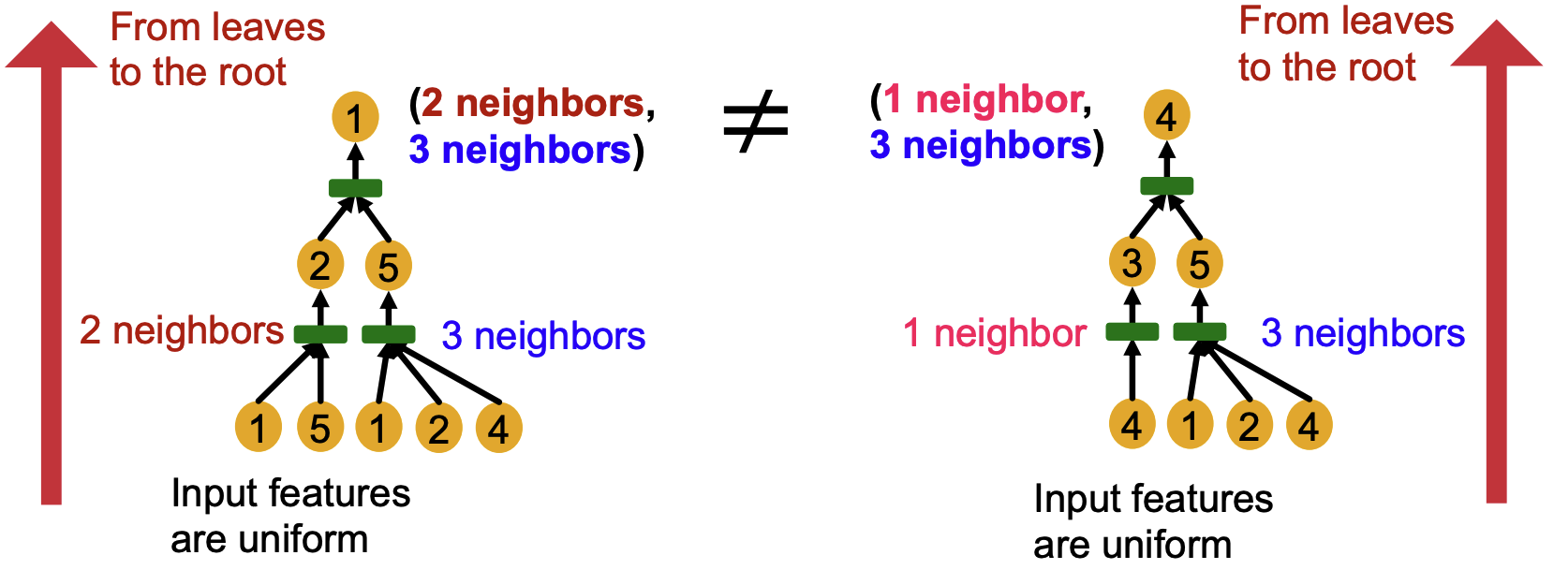
How expressive are GNNs?
Consider that rooted trees of the same depth can be recursively characterized from the leaf nodes to the root nodes
Image credit: Jure Leskovec, http://cs224w.stanford.edu

Slide 31
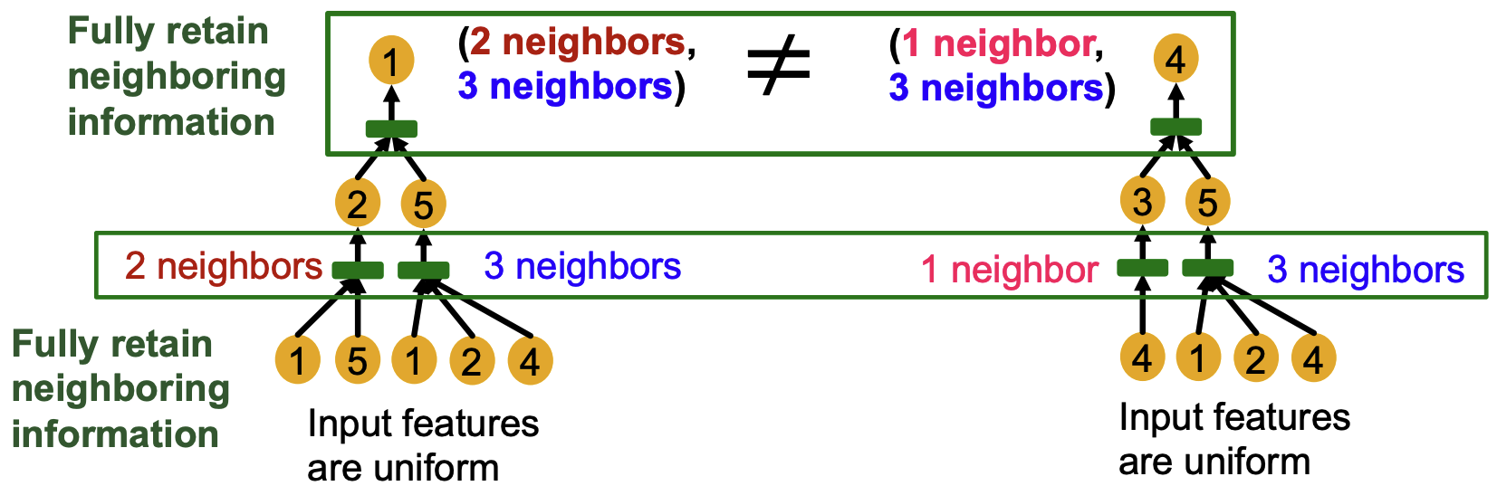
How expressive are GNNs?
If each step of the GNN can fully retain the neighboring information, the node embeddings will be different for different rooted trees (i.e., for different computational graphs)
Image credit: Jure Leskovec, http://cs224w.stanford.edu

Slide 32
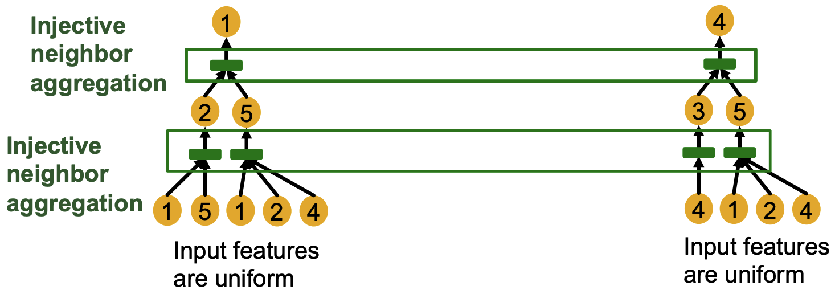
How expressive are GNNs?
Most expressive GNN must use an injective neighbor aggregation and update – though we focus on the aggregation (the update is easier)
Image credit: Jure Leskovec, http://cs224w.stanford.edu

Slide 33
Theoretical analysis of GNN aggregation functions

Slide 34
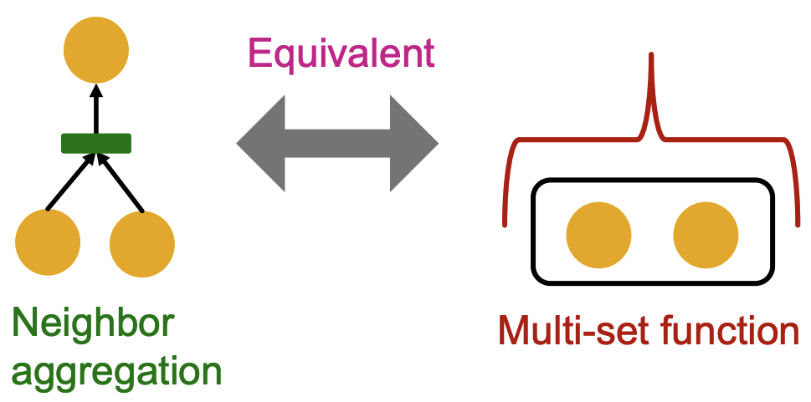
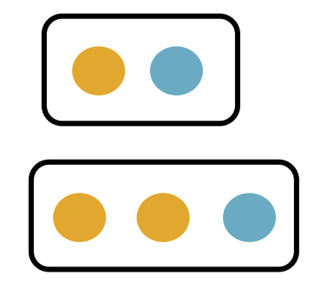
Neighbor aggregation as a function of multisets
Neighbor node aggregation can be viewed as a function of a multi-set (a set with repeating elements, equivalent to an unordered list)
Examples of multi-sets
Image credit: Jure Leskovec, http://cs224w.stanford.edu

Slide 35
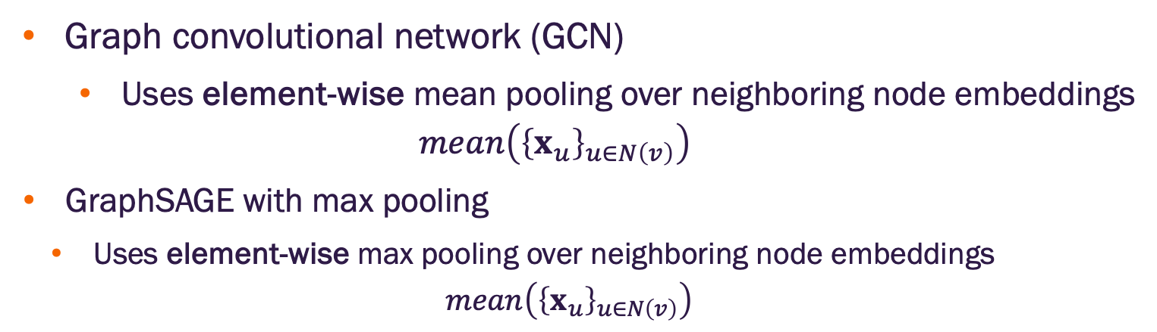
Neighborhood aggregation with GCN and GraphSAGE
Graph convolutional network (GCN)
Uses element-wise mean pooling over neighboring node embeddings
$$mean\left({\left\{x_{u}\right\}}_{u∈N\left(v\right)}\right)$$
GraphSAGE with max pooling
Uses element-wise max pooling over neighboring node embeddings
$$mean\left({\left\{x_{u}\right\}}_{u∈N\left(v\right)}\right)$$

Slide 36
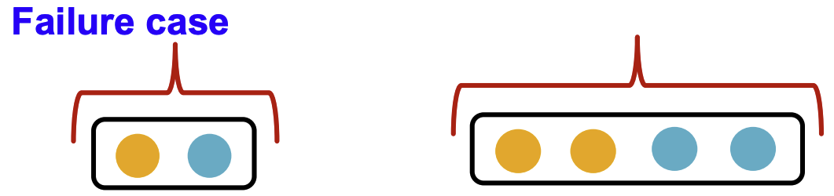
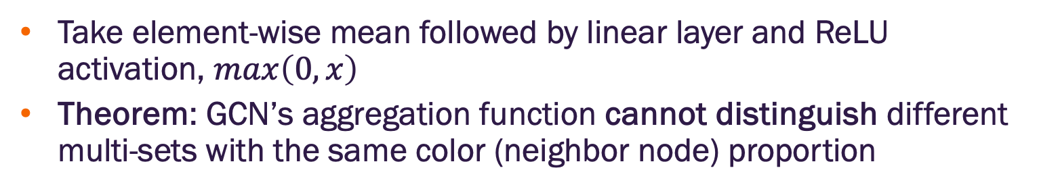
GCN with mean pooling neighbor aggregation
Take element-wise mean followed by linear layer and ReLU activation, $max\left(0,x\right)$
Theorem: GCN’s aggregation function cannot distinguish different multi-sets with the same color (neighbor node) proportion
Image credit: Jure Leskovec, http://cs224w.stanford.edu

Slide 37
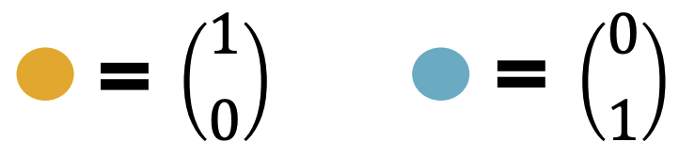
GCN with mean pooling neighbor aggregation
Assume node features (colors) are represented by one-hot encodings
Example: Two distinct colors
This will be sufficient to illustrate how a GCN fails for multisets with same color (neighbor node) proportions
Image credit: Jure Leskovec, http://cs224w.stanford.edu

Slide 38
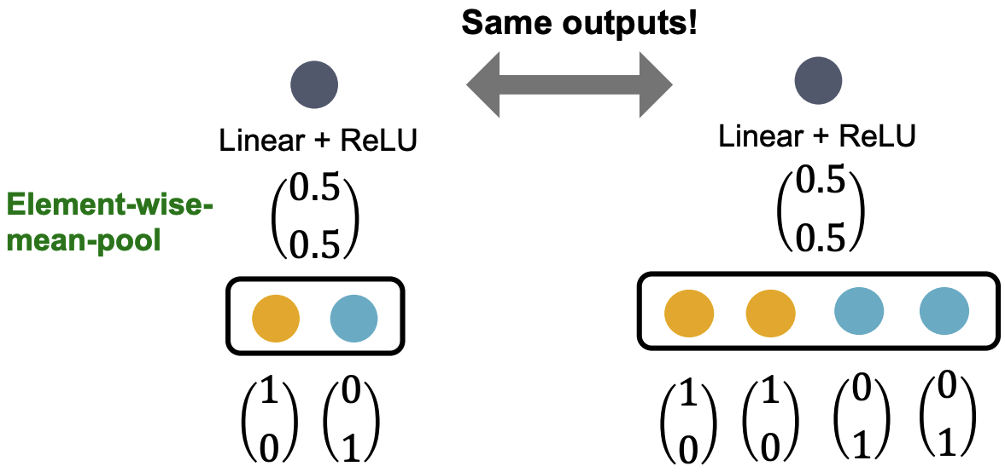
GCN with mean pooling neighbor aggregation
GCN with mean pooling fails to distinguish these multisets
A node with four neighbors
A node with two neighbors
Image credit: Jure Leskovec, http://cs224w.stanford.edu

Slide 39
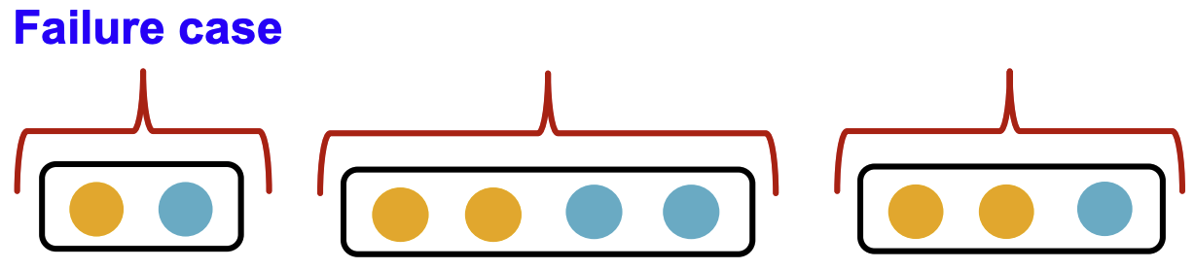
GraphSAGE with max pooling neighbor aggregation
GraphSAGE applies an MLP and then applies pooling (usually max)
Theorem: GraphSAGE with max pooling aggregation cannot distinguish multi-sets with same set of distinct colors
Image credit: Jure Leskovec, http://cs224w.stanford.edu

Slide 40
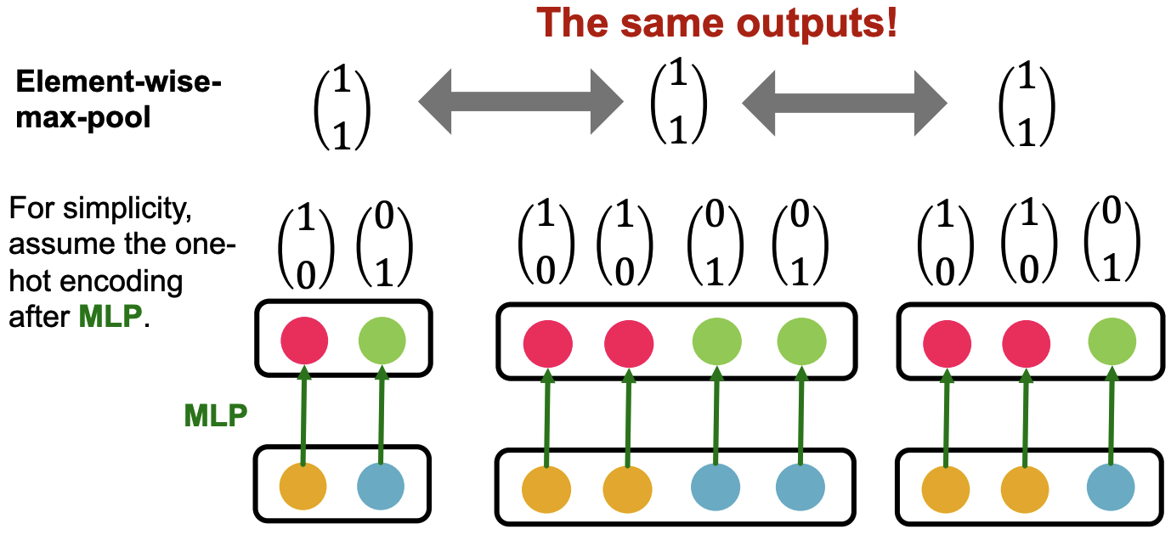
GraphSAGE with max pooling neighbor aggregation
GraphSAGE with max pooling fails to distinguish these multisets
Image credit: Jure Leskovec, http://cs224w.stanford.edu

Slide 41
Summary so far
Expressive power of GNNs can be characterized by analysis of the neighbor aggregation function
Neighbor aggregation viewed as a function over multi-sets
GCN and GraphSAGE fail to distinguish certain multi-sets; hence they’re not injective
Is there a more expressive GNN?

Slide 42
Designing an injective GNN

Slide 43
Designing the most expressive GNN
Goal: Design a maximally expressive message passing GNN
Can be achieved by designing an injective neighbor aggregation function over multi-sets
We will design a neural network that achieves this

Slide 44
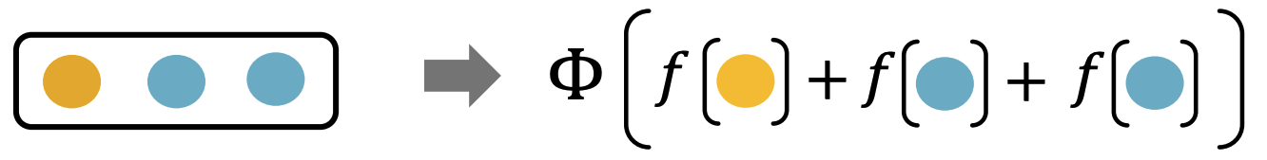
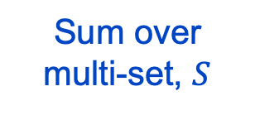
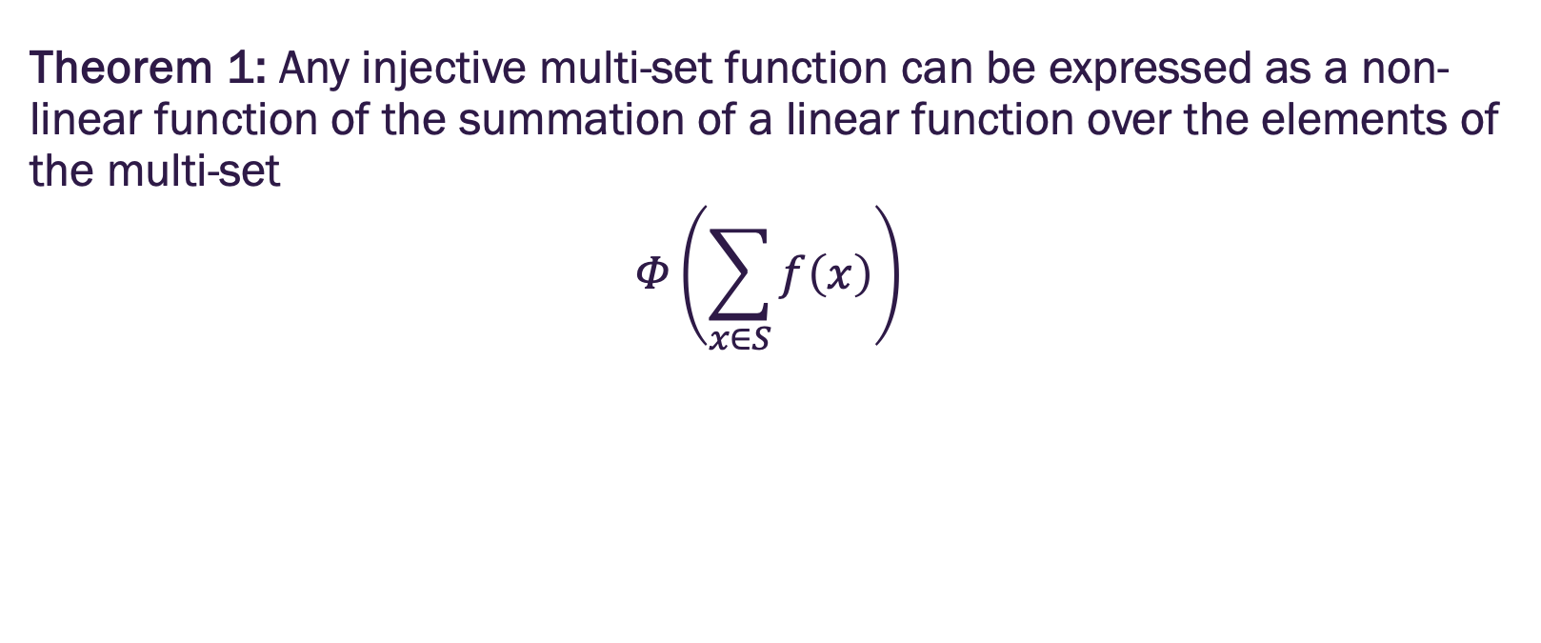
Injective multi-set function
Theorem 1: Any injective multi-set function can be expressed as a non-linear function of the summation of a linear function over the elements of the multi-set
$$Φ\left(\sum_{x∈S}{f\left(x\right)}\right)$$
Some non-linear function
Some linear function
Sum over multi-set, $S$
Image credit: Jure Leskovec, http://cs224w.stanford.edu

Slide 45
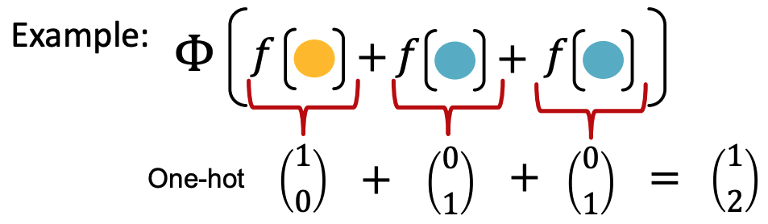
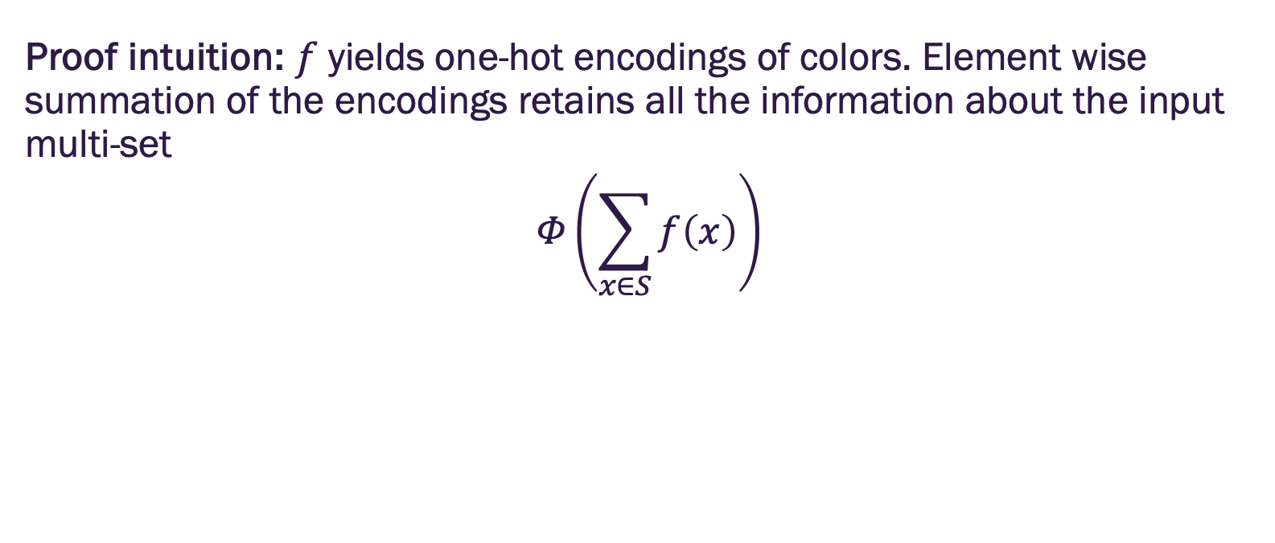
Injective multi-set function
Proof intuition: $f$ yields one-hot encodings of colors. Element wise summation of the encodings retains all the information about the input multi-set
$$Φ\left(\sum_{x∈S}{f\left(x\right)}\right)$$
Image credit: Jure Leskovec, http://cs224w.stanford.edu

Slide 46
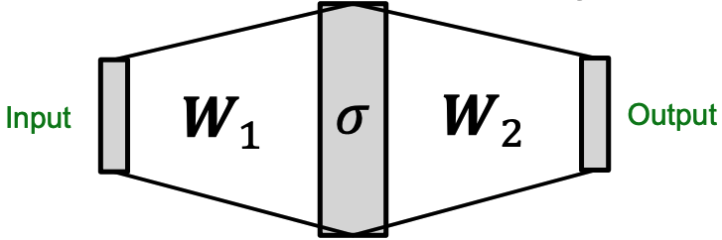
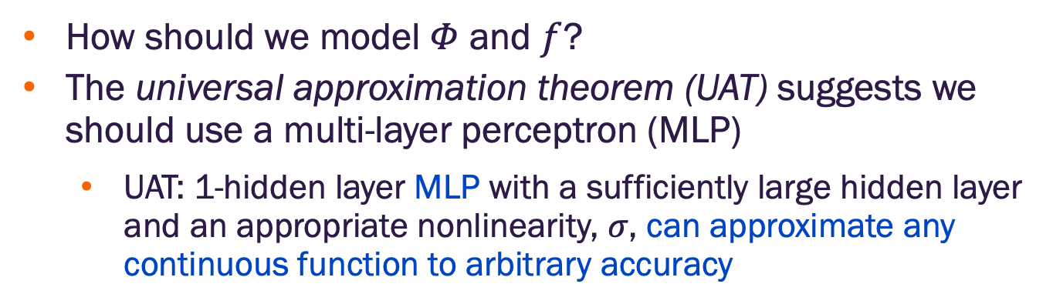
Universal approximation theorem
How should we model $Φ$ and $f$?
The universal approximation theorem (UAT) suggests we should use a multi-layer perceptron (MLP)
UAT: 1-hidden layer MLP with a sufficiently large hidden layer and an appropriate nonlinearity, $σ$, can approximate any continuous function to arbitrary accuracy
Image credit: Jure Leskovec, http://cs224w.stanford.edu

Slide 47
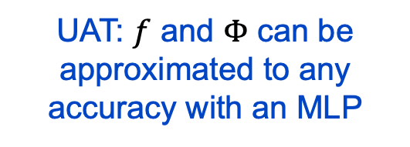
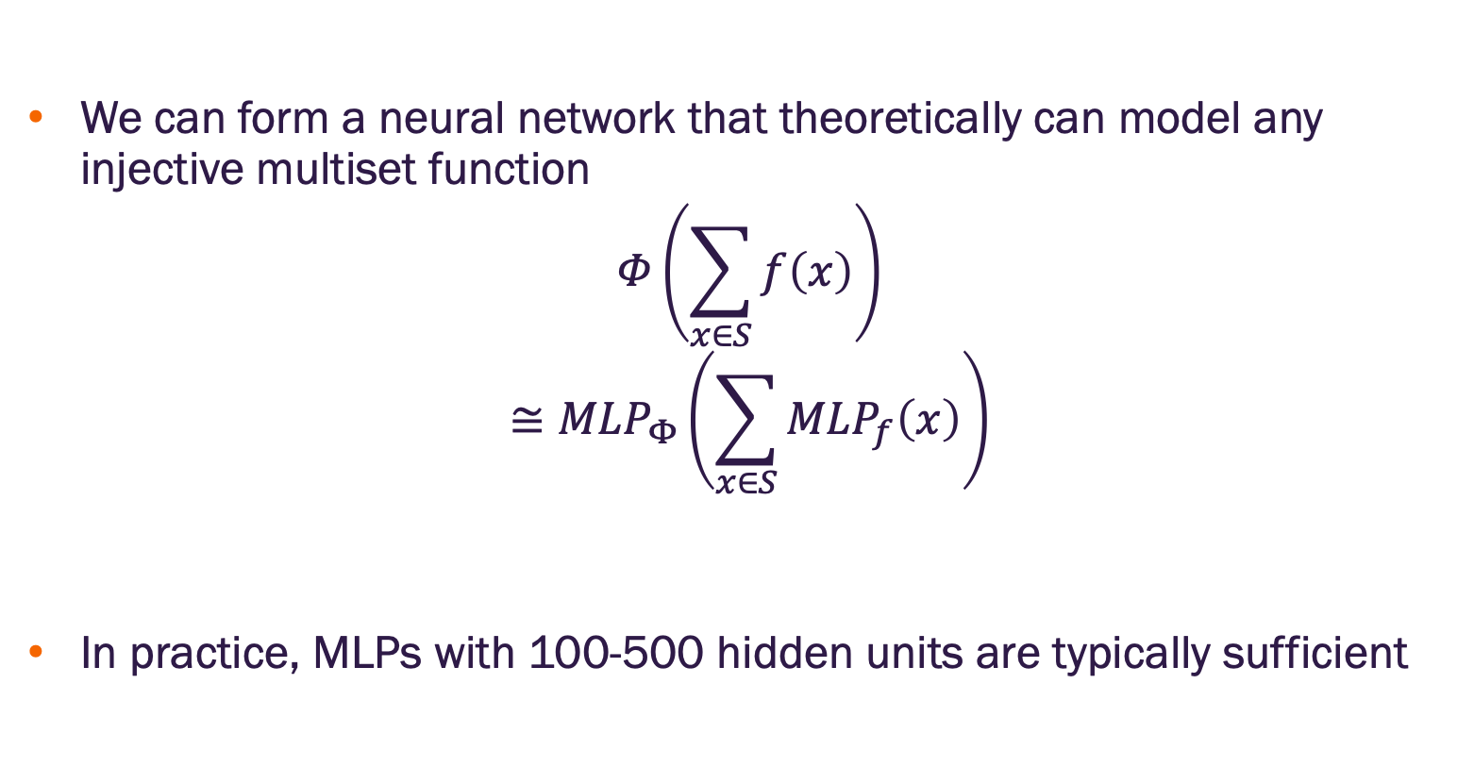
MLP as an injective multi-set function
We can form a neural network that theoretically can model any injective multiset function
$$Φ\left(\sum_{x∈S}{f\left(x\right)}\right)$$
$$≅{MLP}_{Φ}\left(\sum_{x∈S}{{MLP}_{f}\left(x\right)}\right)$$
In practice, MLPs with 100-500 hidden units are typically sufficient
Theorem 1: All injective functions can be expressed in this form
UAT: $f$ and $Φ$ can be approximated to any accuracy with an MLP

Slide 48
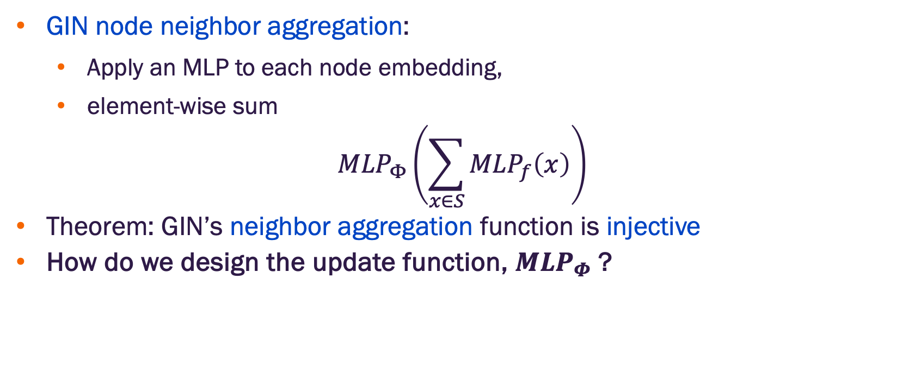
Graph isomorphism network (GIN)
GIN node neighbor aggregation:
Apply an MLP to each node embedding,
element-wise sum
$${MLP}_{Φ}\left(\sum_{x∈S}{{MLP}_{f}\left(x\right)}\right)$$
Theorem: GIN’s neighbor aggregation function is injective
How do we design the update function, ${MLP}_{Φ}$ ?
GIN node aggregation

Slide 49
Weisfeiler-Lehman (WL) Graph Kernel
We will consider the color refinement test for graph isomorphism based on WL Kernel
WL test is a heuristic for graph isomorphism that compares graphs based on their local neighborhood structures.
Caveat: It cannot distinguish certain non-isomorphic graphs (we’ll come back to this)

Slide 50
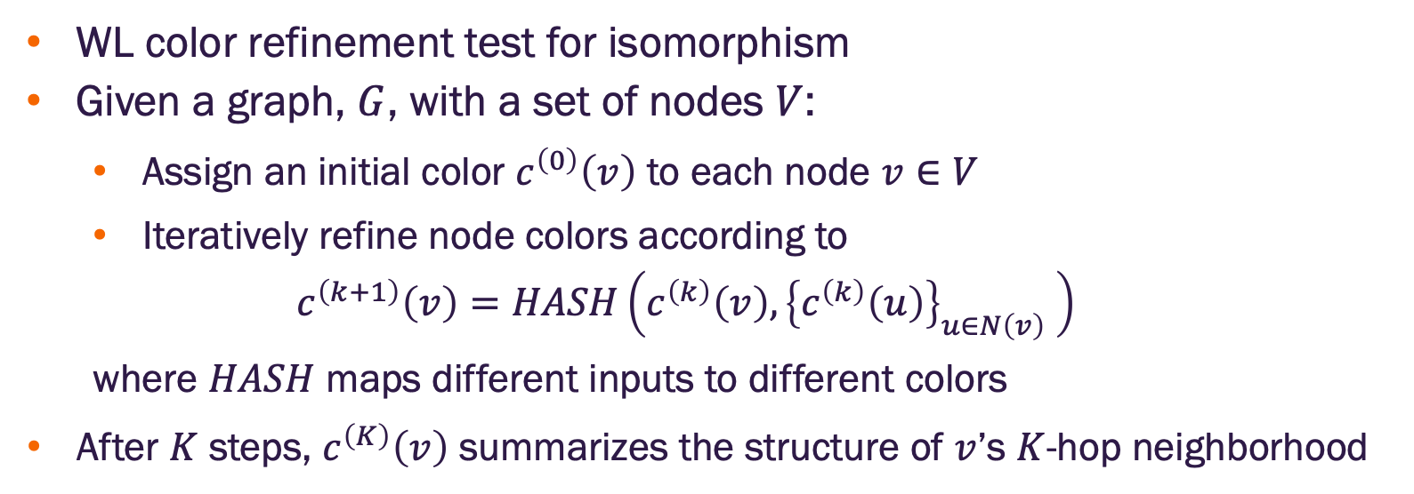
Weisfeiler-Lehman (WL) Graph Kernel
WL color refinement test for isomorphism
Given a graph, $G$, with a set of nodes $V$:
Assign an initial color $c^{\left(0\right)}\left(v\right)$ to each node $v∈V$
Iteratively refine node colors according to
$$c^{\left(k+1\right)}\left(v\right)=HASH\left(c^{\left(k\right)}\left(v\right),{\left\{c^{\left(k\right)}\left(u\right)\right\}}_{u∈N\left(v\right)} \right)$$
where $HASH$ maps different inputs to different colors
After $K$ steps, $c^{\left(K\right)}\left(v\right)$ summarizes the structure of $v$’s $K$-hop neighborhood

Slide 51
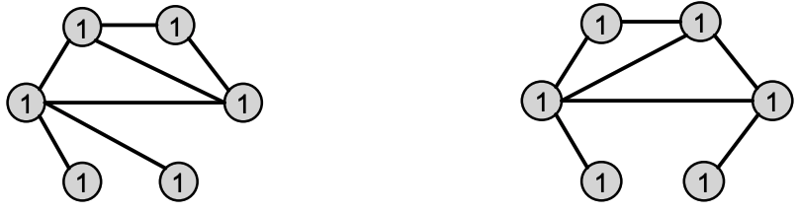
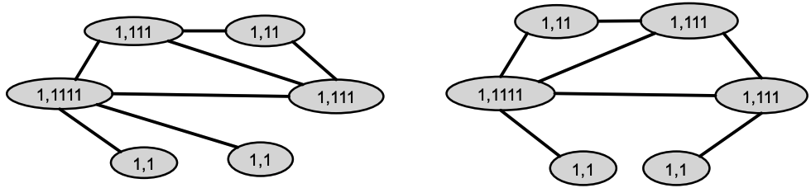
Color refinement on two graphs
Assign the initial colors
Aggregate neighboring colors
Image credit: Jure Leskovec, http://cs224w.stanford.edu

Slide 52

Color refinement on two graphs
Aggregate neighboring colors
Injectively HASH the aggregated colors (i.e., make sure each distinct multi-set maps to a distinct color)
Image credit: Jure Leskovec, http://cs224w.stanford.edu

Slide 53

Color refinement on two graphs
Iterate until a stable coloring is reached (i.e., color assignments don’t change)
Two graphs are considered isomorphic if they have the same color set (though false positives happen with this test)
Not isomorphic
Image credit: Jure Leskovec, http://cs224w.stanford.edu

Slide 54

The GIN model update function
GIN uses a neural network to model the injective HASH function
$$c^{\left(k+1\right)}\left(v\right)=HASH\left(c^{\left(k\right)}\left(v\right),{\left\{c^{\left(k\right)}\left(u\right)\right\}}_{u∈N\left(v\right)} \right)$$
Theorem: Any injective function over the tuple
$$c^{\left(k\right)}\left(v\right),{\left\{c^{\left(k\right)}\left(u\right)\right\}}_{u∈N\left(v\right)}$$
can be modeled as
$${MLP}_{Φ}\left[\left(1+ε\right){MLP}_{f}\left(c^{\left(k\right)}\left(v\right)\right)+\sum_{u∈N\left(v\right)}{{MLP}_{f}\left(c^{\left(k\right)}\left(u\right)\right)}\right]$$
where $ε$ is a learnable scalar
Node neighbor embeddings
Node embedding

Slide 55


The GIN model update function
If the the input feature $c^{\left(0\right)}\left(v\right)$ is a one-hot, element-wise summation is injective
We only need to make sure $Φ$ is injective
$${GINConv\left(c^{\left(k\right)}\left(v\right),{\left\{c^{\left(k\right)}\left(u\right)\right\}}_{u∈N\left(v\right)}\right)=MLP}_{Φ}\left[\left(1+ε\right){MLP}_{f}\left(c^{\left(k\right)}\left(v\right)\right)+\sum_{u∈N\left(v\right)}{{MLP}_{f}\left(c^{\left(k\right)}\left(u\right)\right)}\right]$$
Train this MLP to generate a “one-hot” as input to the next layer
Image credit: Jure Leskovec, http://cs224w.stanford.edu

Slide 56

GIN’s node embedding updates
Given a graph, $G$, with a set of nodes $V$:
Assign an initial vector $c^{\left(0\right)}\left(v\right)$ to each node $v∈V$
Iteratively update node vectors according to
$$c^{\left(k+1\right)}\left(v\right)=GINConv\left(c^{\left(k\right)}\left(v\right),{\left\{c^{\left(k\right)}\left(u\right)\right\}}_{u∈N\left(v\right)} \right)$$
where $GINConv$ maps inputs to different embeddings
After $K$ steps, $c^{\left(K\right)}\left(v\right)$ summarizes the structure of $v$’s $K$-hop neighborhood

Slide 57
GIN and the Weisfeiler-Lehman graph kernel
GIN can be understood as a differentiable neural version of the WL graph Kernel
Advantages of GIN over the WL graph kernel:
Node embeddings are low-dimensional; they can capture fine-grained similarity of different nodes (e.g., by cosine similarity)
Parameters of the update function can be learned for downstream tasks (i.e., node embeddings are useful in downstream tasks)
 | Update target | Update function
WL Graph Kernel | Node colors (one-hot) | HASH
GIN | Node embeddings (low-dim vectors) | GINConv

Slide 58
Expressive power of GIN
The equivalence of GIN and WL graph kernel indicates they have the same expressiveness
Two graphs can be distinguished by GIN if and only if they can be distinguished by the WL kernel
How powerful is this?
WL kernel has been theoretically proven and empirically shown to distinguish most real-world graphs
But, sadly, not all

Slide 59

GIN is not a panacea
The WL kernel (and hence GIN) cannot distinguish between some important graph structures
It also cannot count important sub-structures such as cycles and cliques

Slide 60

Are the limitations of GINs important?
Consider the inability to count cycles
The bonds between atoms in chemical compounds often form cycles
For example, hexagons are very common in organic compounds
Image credit: Jure Leskovec, http://cs224w.stanford.edu

Slide 61

Are the limitations of GINs important?
Consider the inability to count cliques
Cliques appear in many important application networks
Fraud detection in e-commerce networks
Protein complexes in PPI networks
Hooi et al. 2016
Vlaic et al. 2017

Slide 62

What should a “perfect” GNN do?
A k-layer GNN embeds a node based on the k-hop neighborhood structure
A perfect GNN should build an injective function between neighborhood structure (regardless of hops) and node embeddings

Slide 63


What should a “perfect” GNN do?
Ignoring node attributes, if two nodes have the same neighborhood structure, they should have the same embedding
If two nodes have different neighborhood structures, they should have different embeddings
Image credit: Jure Leskovec, http://cs224w.stanford.edu

Slide 64
Imperfections of existing GNNs
We have already seen that GINs (our most expressive message passing GNN) fails to satisfy the second condition
Additionally, sometimes we want the first condition to be violated based on their position in the graph – position-aware tasks such as street maps
There are methods that are more expressive than WL kernel that start to address these limitations
Structurally-aware GNNs (e.g., see Kanatsoulis 2024)
Position-aware GNNs (e.g., see You 2019)

Slide 65


